Slide 1
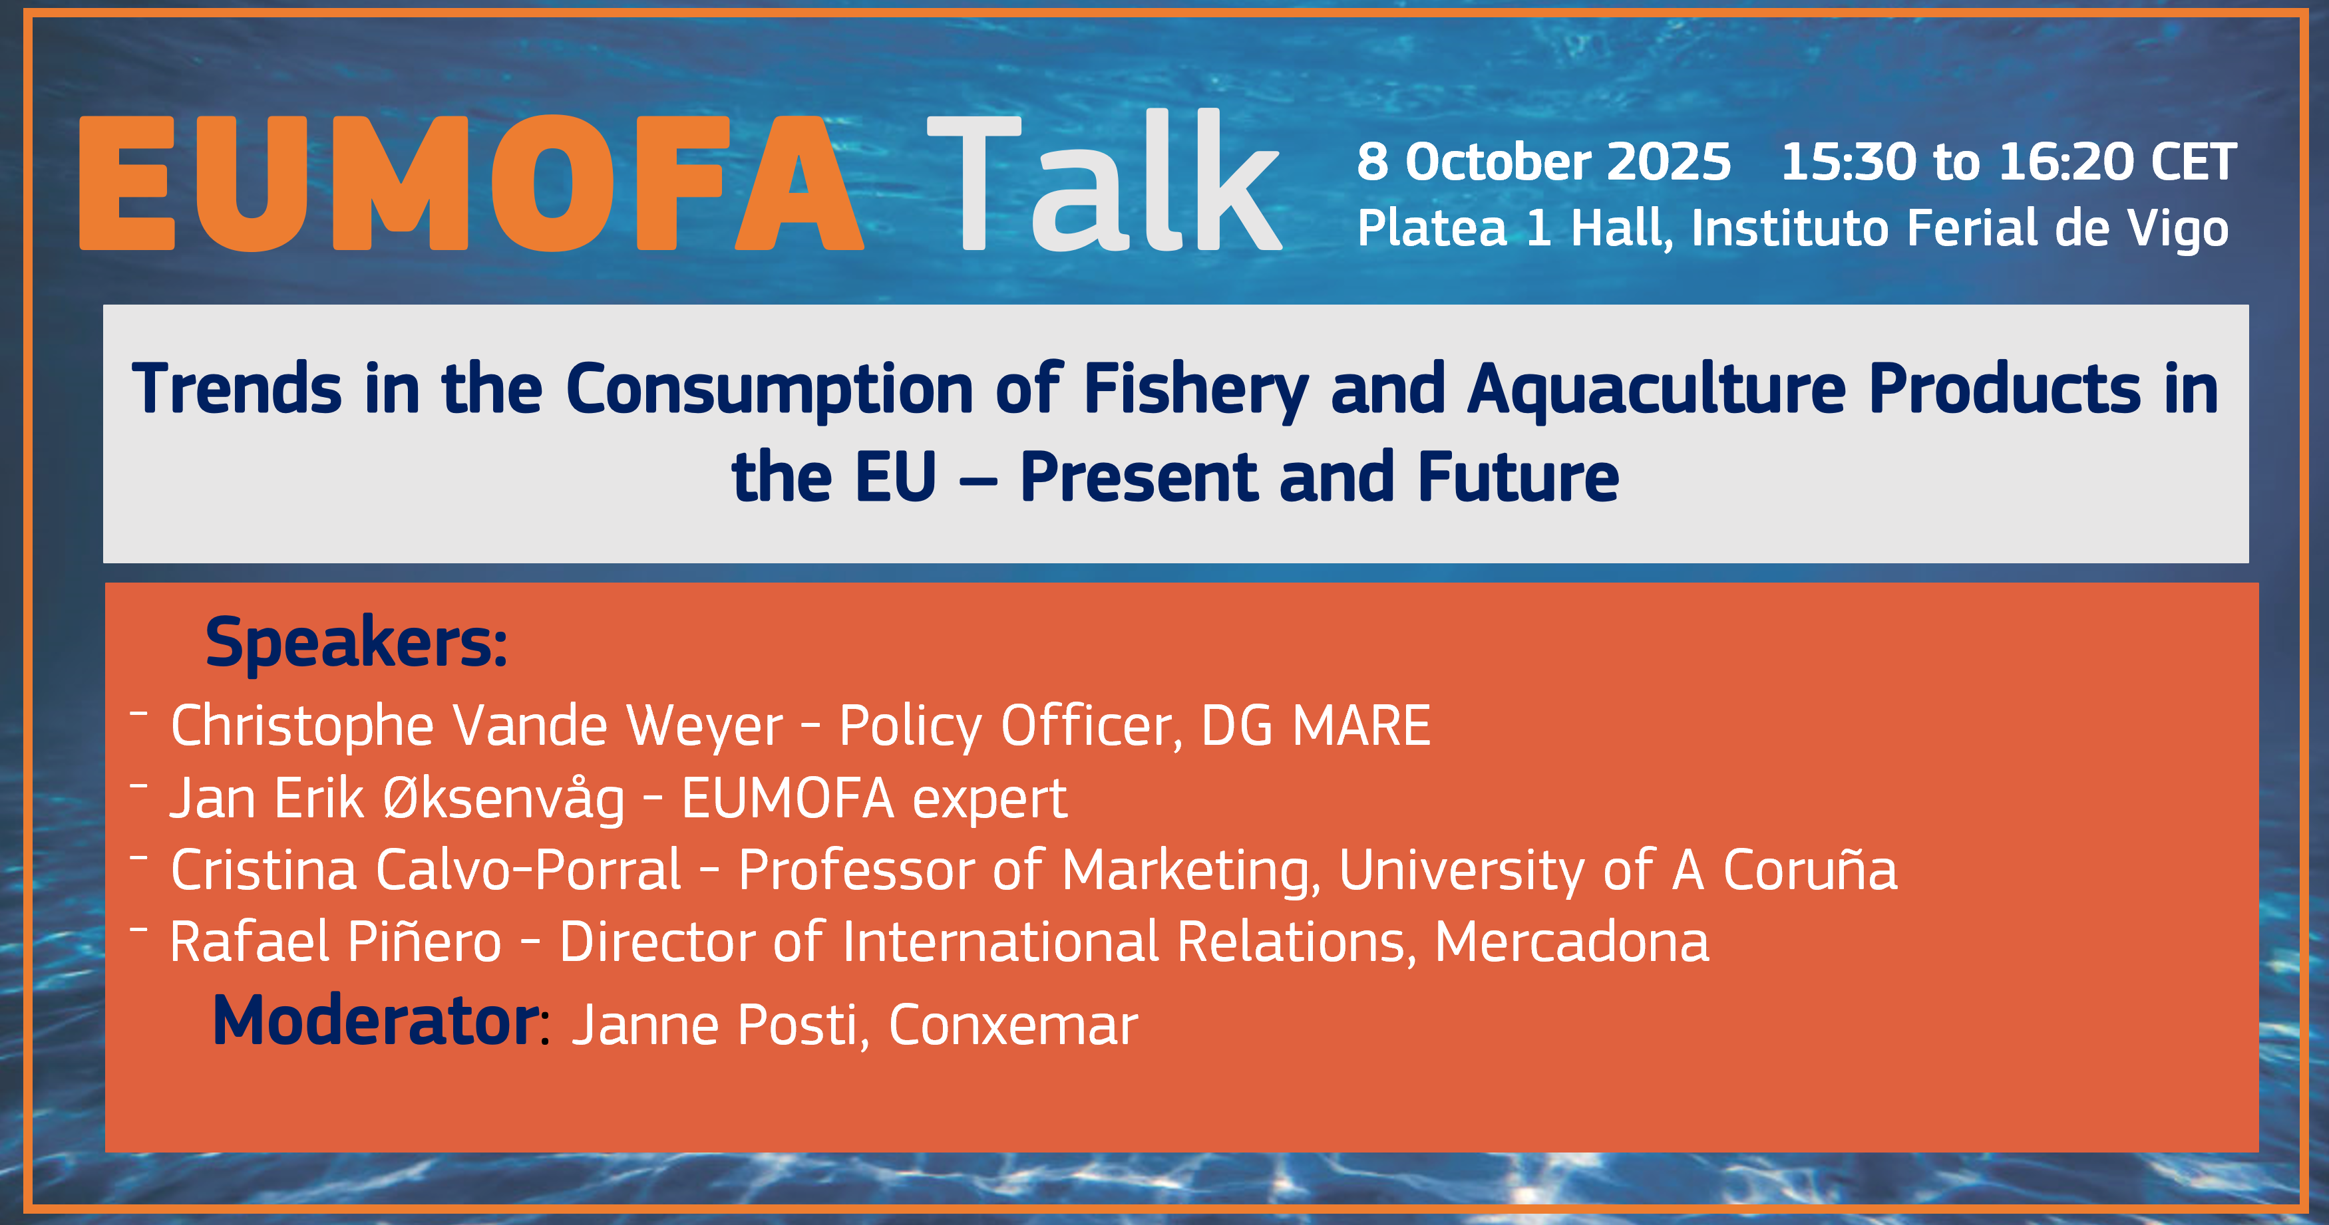

Slide 2
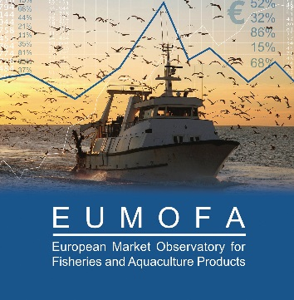
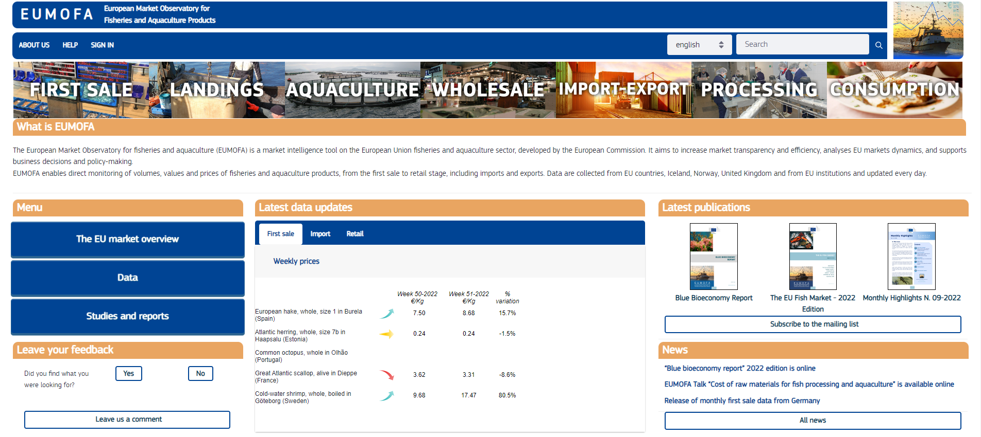
The Commission has the legal obligation to:
Provide market intelligence to stakeholders
In close cooperation with the MS
Data
Publications
Talks and conferences
Notes:
Ferdig

Slide 3
EU fisheries and aquaculture consumption trends
EUMOFA market analyst: Jan Erik Øksenvåg
Conxemar – October 8, 2025

Slide 4
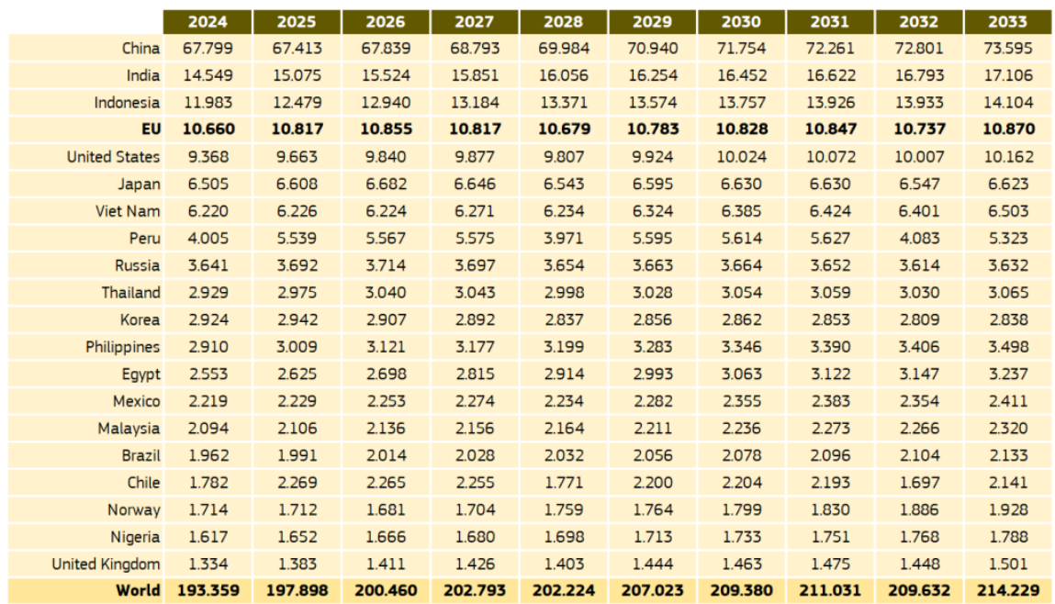
EU in the world –
apparent consumption of FAP
In 1000 tonnes

Slide 5
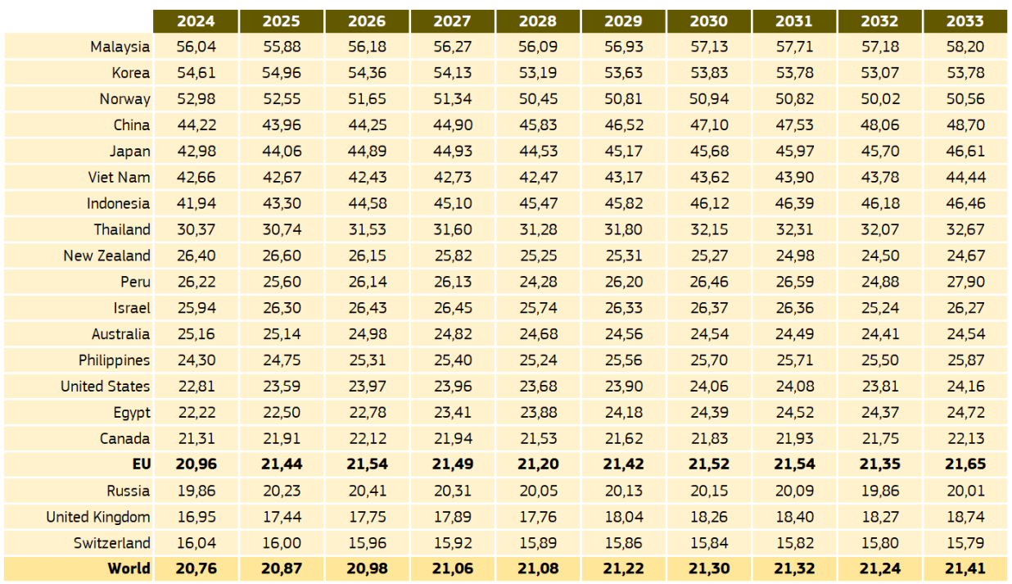
EU in the world –
apparent consumption of FAP
In kg/capita

Slide 6
FAP consumption in the EU vs
recommended FAP consumption
General (average) recommendation from EU MS
(European Commission, Health Promotion and Disease Prevention Knowledge Gateway)
Consumption frequency: at least 2 times/week
Portion/meal size: 150 grams
Conversion factor: 0,6
  Edible to live weight
According to recommendations:
26 kg/capita/year

Slide 7
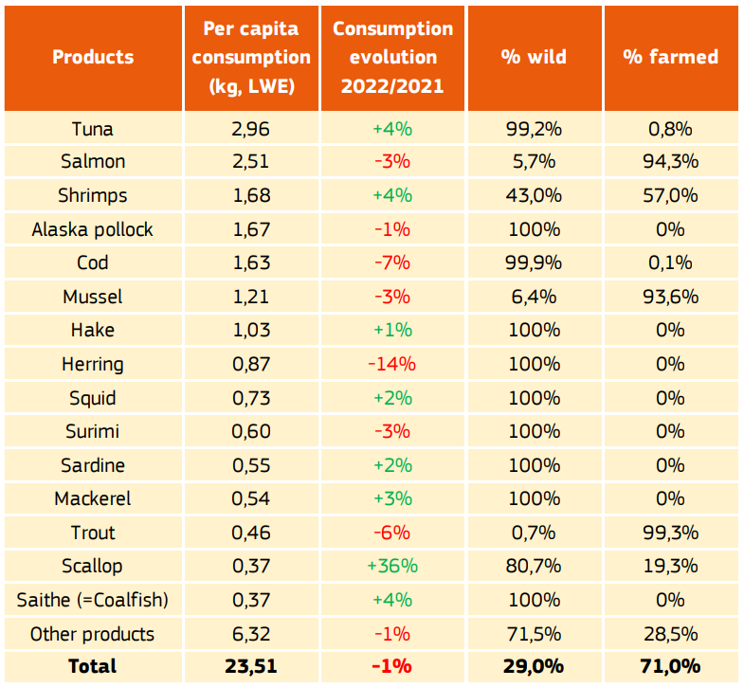
Top products consumed in the EU

Slide 8
Eurobarometer survey shows new trends in fishery and aquaculture products consumption
EU consumer habits
Decline in overall consumption frequency since the 2021 survey
  Only one-third of respondents consume fishery and aquaculture products at least once a week
  The share of respondents who never consume fishery and aquaculture products at home has risen to 15%,
The cost of products has become the most influential factor (55%) in the purchasing decisions of European consumers for fish and seafood.
  Consumption of frozen and tinned FAP surpassing fresh

Slide 9
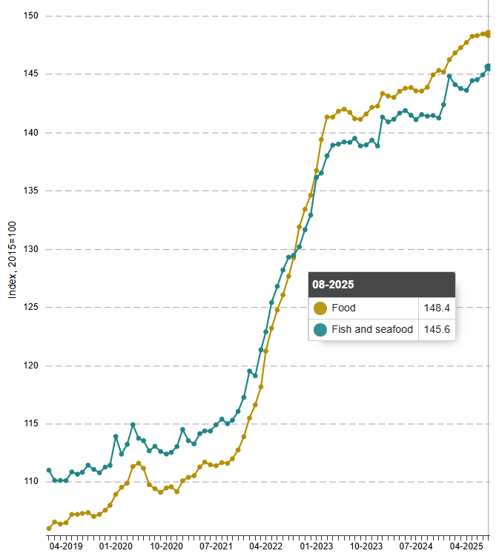
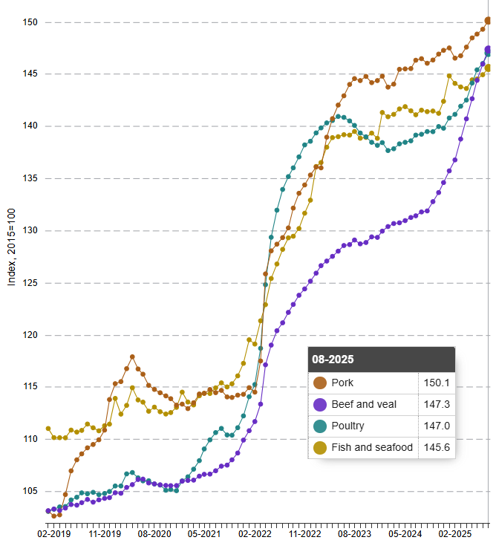
Inflation – food items

Slide 10
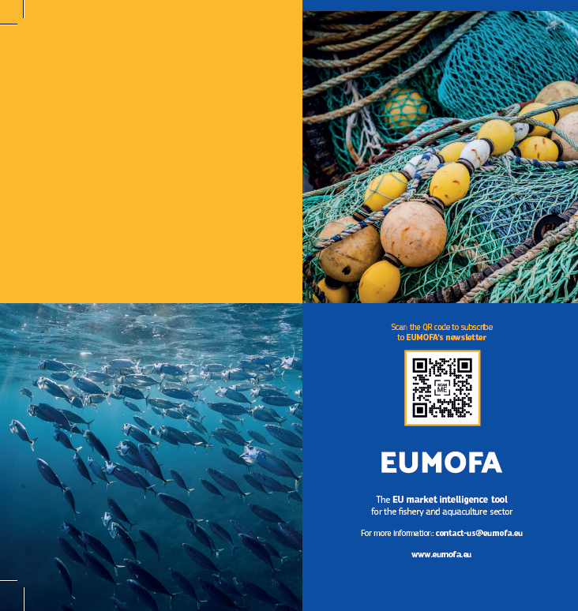


Thank you for
your attention!
www.eumofa.eu
contact-us@eumofa.eu
EU Maritime & Fish
@EU_MARE

