Slide 1

Seafood Consumption in the EU
Guus Pastoor, 02-10-2024

Slide 2
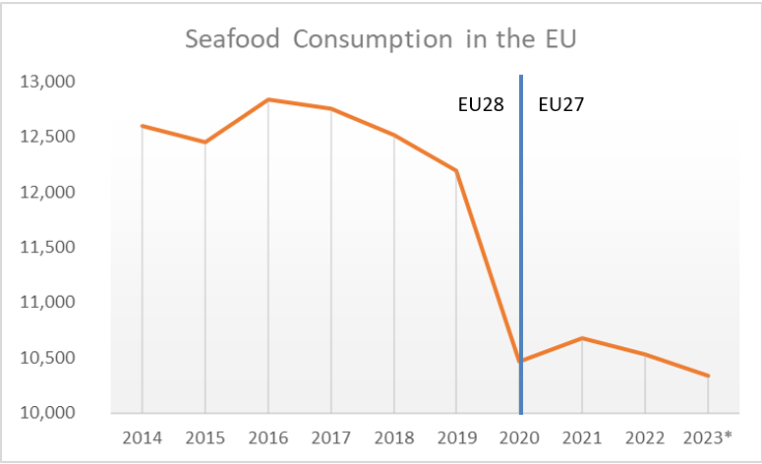
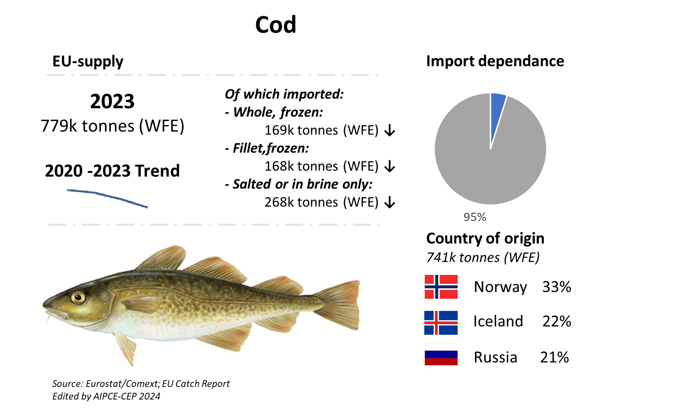
Total consumption EU
In general, a downward trend
Seen in most of the seafood species (whitefish, salmon, tuna, cephalopods and shrimp)
Decreasing supply via third country imports and own EU production
Seafood consumption in the EU
Source: EU Seafood Supply Synopsis 2024

Slide 3
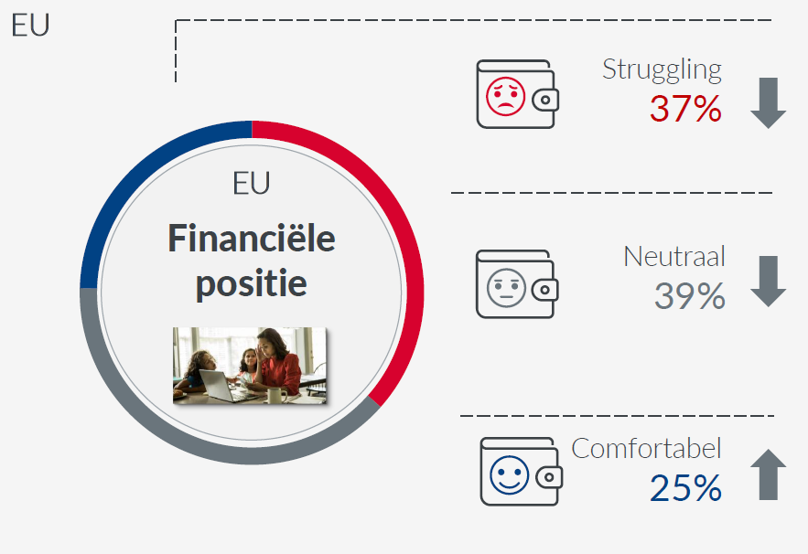
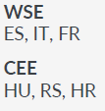
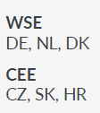
Total consumption EU
Economic concerns due to inflation
1 in 3 Europeans struggle to make ends meet
Households buy less volume, but spend more money
Seafood consumption in the EU
They are struggling financially to make ends meet.
Generally, no financial concerns, they’ll manage
They don’t need to restrict themselves or can afford a lot
Source: GfK Behavior Change Mei ‘23

Slide 4
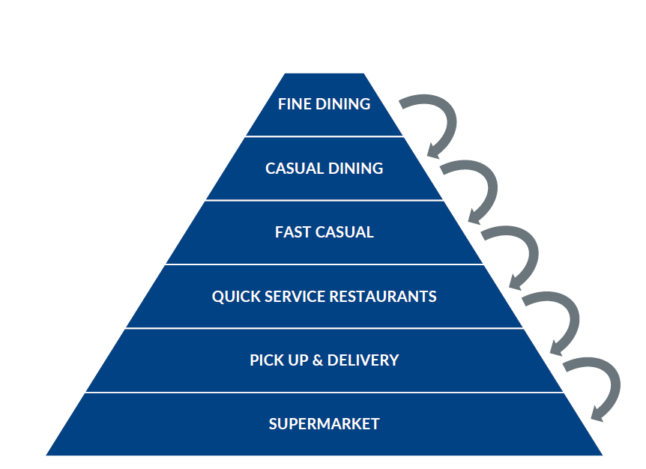
Total consumption EU
Inflation important driver for decrease seafood consumption
Consumers switch to cheaper substitutes within seafood (farmed) or outside seafood (chicken, meat/fish substitute)
Downtrading trend
More focus on promotions
Shrinkflation
Seafood consumption in the EU

Slide 5

Total consumption EU
EU is slowly recovering, but promotion of seafood consumption essential
Find solutions to increase quota utilization in the EU and focus on aquaculture production
Maximize added value seafood products
Reduce seafood waste, valorize by products
Promote the benefits of eating seafood (healthy proteins, omega-3, etc.)
Clarifying the role of seafood in the protein transition
Be proud of the seafood industry
Seafood consumption in the EU

