Slide 1
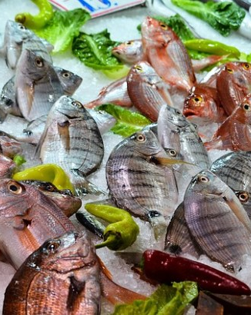

Fish and aquaculture products consumption.
Recent trends and consumer behaviours in Italy
An Italian fish market overview
June 2023
Questa foto di Autore sconosciuto è concesso in licenza da CC BY-ND

Slide 2
ITEMS
Scenary
Highlights
Fishery and aquaculture production: deep decrease in the last 10 years, -40% (273,000 Tonnes estimated in 2021; 2010 production: 455.000 tons.
In the last 10 years the fishing fleet has suffered a 10% reduction in the number of vessels and more than 20% of gross tonnage.
The progressive growth of dependence on supplies from abroad: almost 90% of domestic consumption is supplied by imports. In 2022, the deficit in the fish trade balance reached 6,4 billion € (1,132 billion tons of import against 174 million tons of export).
Italian fish and aquaculture sector scenary
The heavy dependence on imports of seafood

Slide 3
ITEMS
Consumption Recent trends
Highlights
Per capita consumption remains around 20.7 kg, equally distributed between domestic and non-domestic consumption (HoReCa).
In the last 10 years slight drop of seafood consumption.
Domestic consumption has increased during the pandemic period (more staying at home, and closure of restaurants)
In 2022, drop in the domestic consumption, due probably to the economic crises related to the war and to the price inflation.
Fish and aquaculture products consumption: recent trends
World and european crises impact on seafoood consumption

Slide 4
ITEMS
Domestic consumption survey
How it works
Families panel (9,000) that register their food shopping.
It is a representative panel of the universe of Italian families (24,8 million).
Panel stratified by geographical area and by demographic variables.
Families stratified by components, age, income, children presence.
Purchases registered by date, the family component who makes the purchase, distribution channel, price, product bar code, special offers, total expense.
Domestic consumption Survey: The NielsenIQ Company Consumer panel

Slide 5
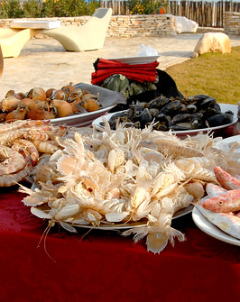
Household consumption trend: a comparison with the food basket
1

Slide 6
Household food consumption basket
Overview of food shopping: the food basket composition
Notes:
INSERIRE QUALCHE DATO SUL CALO DEI VOLUMI

Slide 7
Household food consumption: recent trends
Overview of food shopping: more expense but less quantities

Slide 8
Household seafood consumption trend: overall and by product category
2

Slide 9
Household seafood consumption: recent trends
Overview of seafood purchases

Slide 10
Household seafood consumption: prices trend
Overview of seafood purchases: trend prices
Notes:
In 2023 price inflation confirmed.

Slide 11
Household seafood consumption: the categories
Overview of seafood purchases: the composition by category

Slide 12
Household seafood consumption: categories trends
Overview of seafood purchases: details by category

Slide 13
Household fish consumption trend by product
3

Slide 14
Household seafood consumption: the most important products
Overview of seafood purchases by product

Slide 15
Household seafood consumption: the most important fresh products
Overview of seafood purchases by product

Slide 16
Household seafood consumption: the most important processed products
Overview of seafood purchases by product

Slide 17
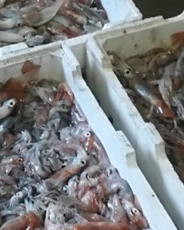
Household fish consumption trend by consumer profile
4
Questa foto di Autore sconosciuto è concesso in licenza da CC BY-SA

Slide 18
Household seafood consumption: the consumer profiles
Overview of seafood purchases by consumer profile
Notes:
Purchasing manager: the family component responsable for food purchasing – who makes food purchases more frequently.

Slide 19
Household seafood consumption: the consumer profiles
Overview of seafood purchases by consumer profile
PRE-FAMILIES: Single or young couple without children - NEW-FAMILIES: Families with young children
MATURING-FAMILIES: with young children and teenagers - ESTABILISHED-FAMILIES: with teenagers
POST FAMILIES: Singles or families with sons over 18 - OLDER COUPLES: Couple over 55 years - OLDER SINGLES: Singles over 55 years
Notes:
PRE-FAMILIES: Single or young couple without children
NEW-FAMILIES: Families with young children
MATURING-FAMILIES: with young children and teenagers
ESTABILISHED-FAMILIES: with teenagers
POST FAMILIES: Singles or families with sons over 18
OLDER COUPLES: Couple over 55 years
OLDER SINGLES: Singles over 55 years

Slide 20
Household seafood consumption: the consumer profiles
Overview of seafood purchases by consumer profile
Seafood Purchases Share by family type
(2022 - volume)
Seafood Purchases Share by family income
(2022 -volume)
Highilights
The older couples (components over 55 years) represent the largest share of seafood purchases, while New family (Families with young children) and prefamily (Single or young couple without children) the smallest.
The «around» average income families (above and below average affluency) represent the largest share of seafood purchases.
Low affluency, the smallest one (due simply to their less purchasing power).
High affluency represent «only» 20% becasue probably they prefer to eat fish at the restaurant…..

Slide 21
Italian Household fish consumption by purchase channel
5
Questa foto di Autore sconosciuto è concesso in licenza da CC BY-SA

Slide 22
Household seafood consumption by distribution channel
Highilights
The share of the distribution channels used for the purchase of fish products is almost equally distributed among the categories (frozen, canned, smoked, dried and fresh)
In 2022 only minimarket improved the performance
Compared to pre-covid, superstores, supermarkets and discount stores registered a good performance, while the traditional channel loses many percentage points
Seafood Purchases Share by distribution channel (volume)
Seafood Purchases trend by distribution channel (volume)

Slide 23
p.piozzi@ismea.it
Thanks for your attention

